Slide 1
How Bones Shape our Bodies, Society, and Religion
Paul Fagan, DO, FAAOS
FVUUF
Sunday, 10/25/2026

Slide 2
Overview
Basic science of bone
How bones shape society and religion
  Bones as vessels of the divine
  Bones as social mirrors
  Bones as ancestral anchors
Conclusion

Slide 3
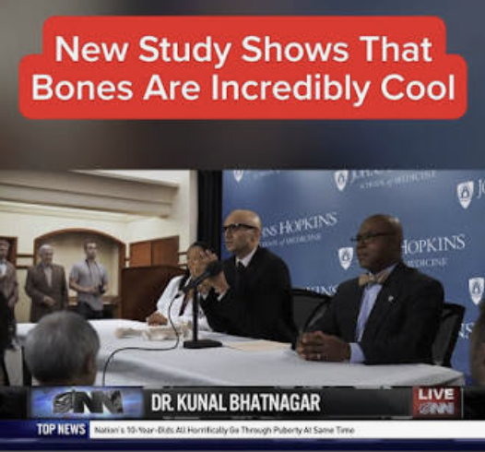
Bones are cool
New Study

Slide 4
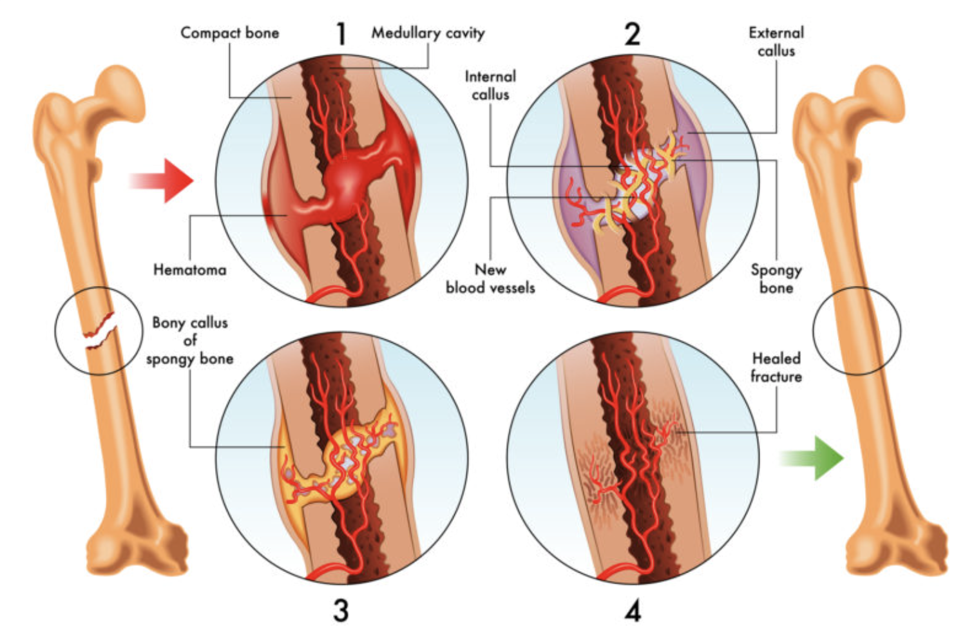
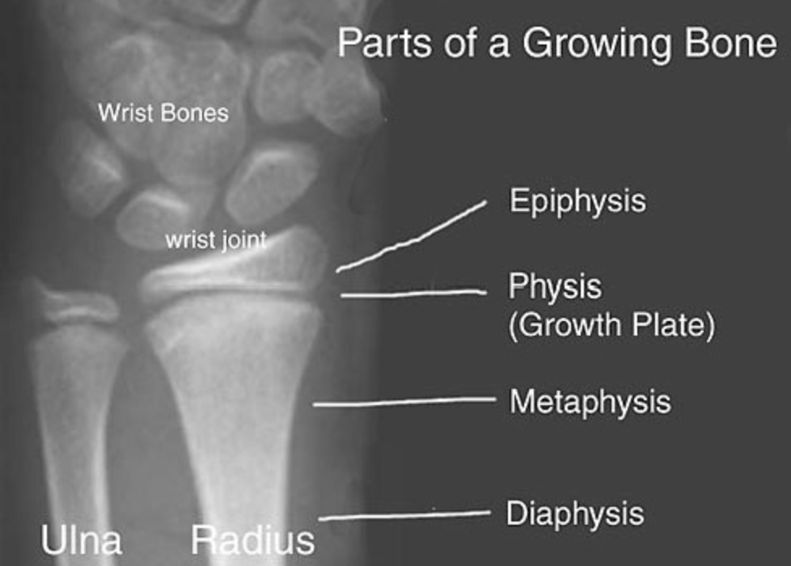
Basic science of bone
Bone is a dynamic, living tissue
  Growth
  Aging
  Fracture and healing

Slide 5
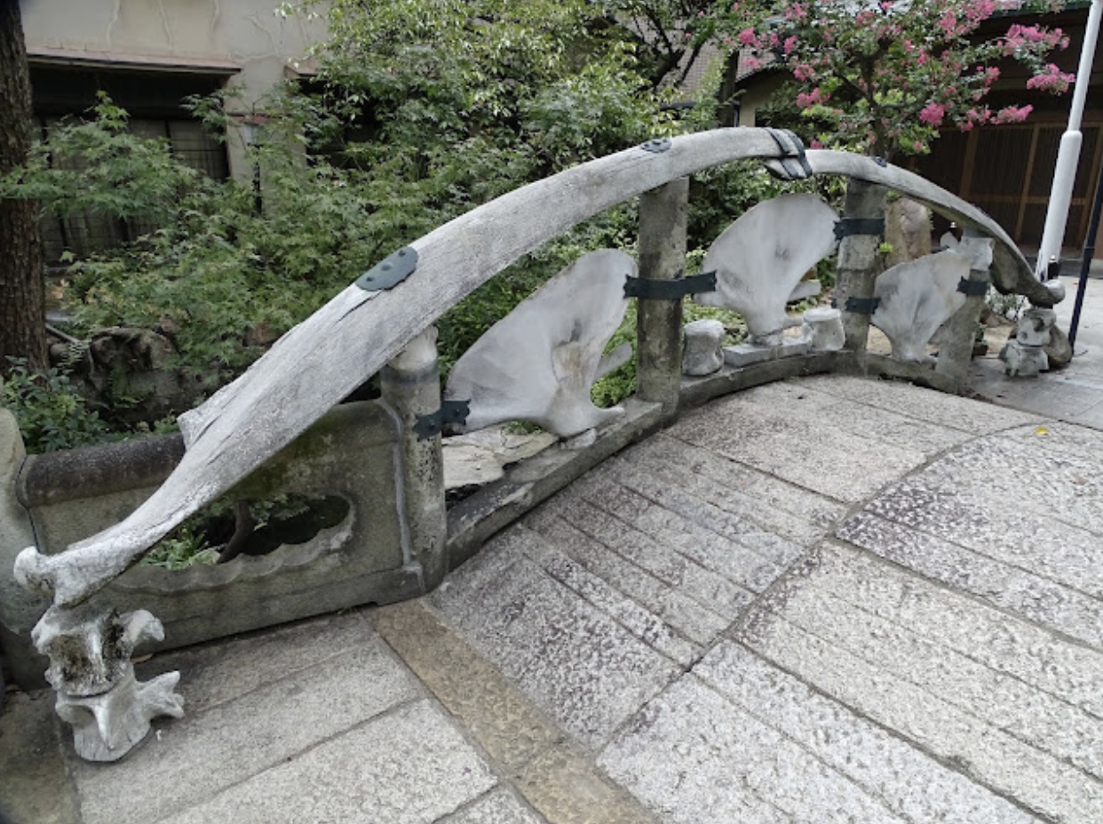
Bones as vessels of the divine
Bones as cultural artifacts

Slide 6
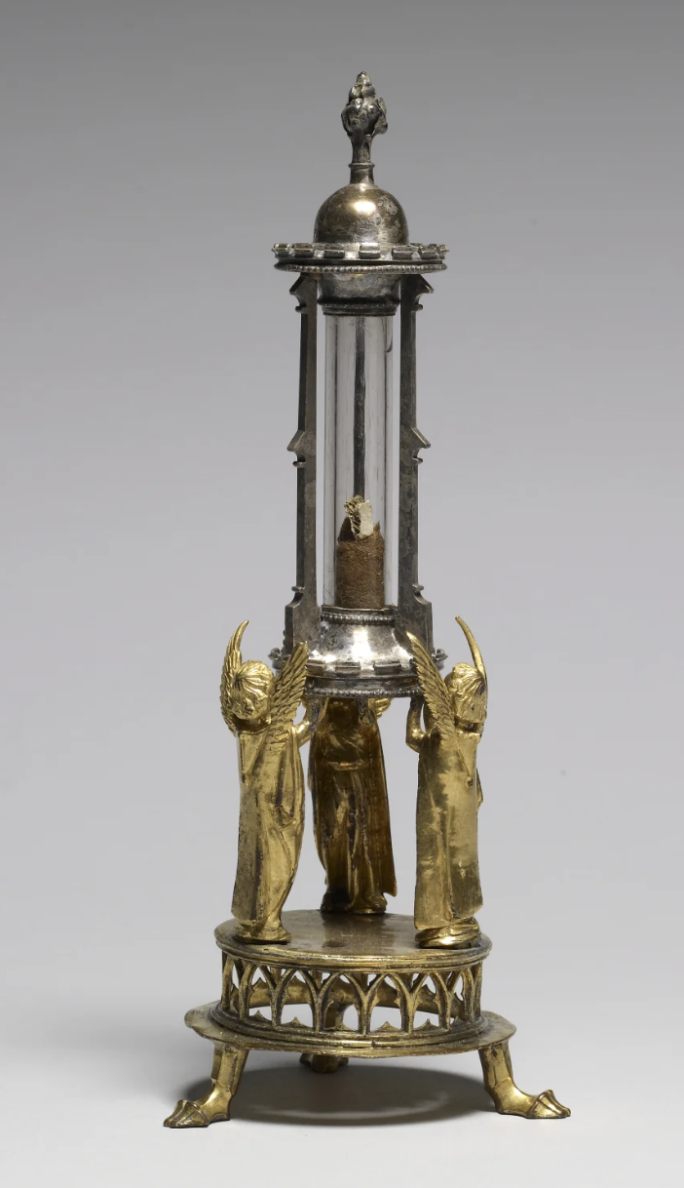
Bones as vessels of the divine - relics
Christian reliquaries

Slide 7
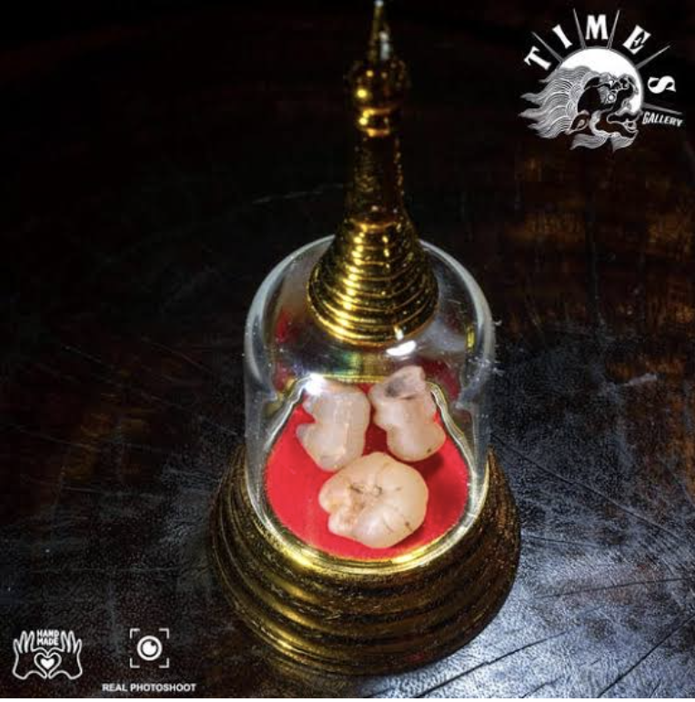
Bones as vessels of the divine - relics
Buddhist Sarira

Slide 8
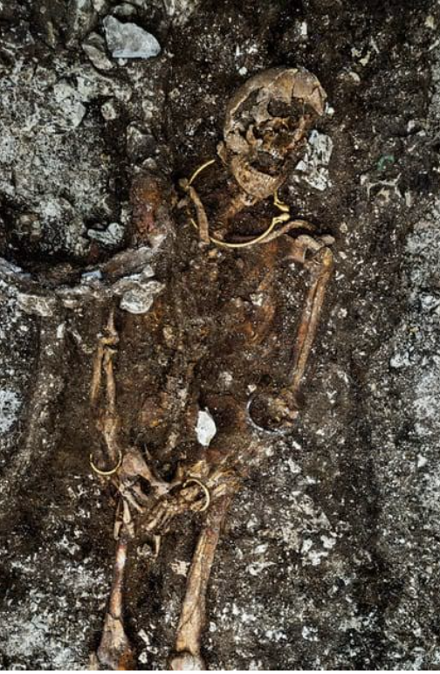
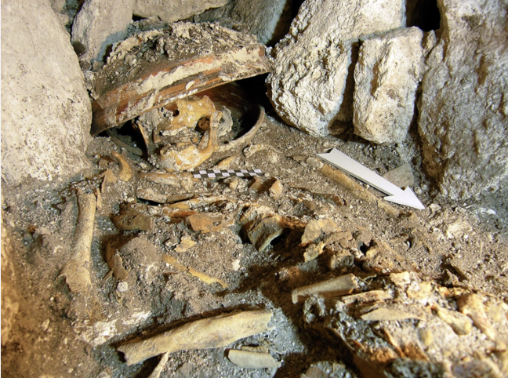
Bones as social mirrors
Hierarchical burial

Slide 9
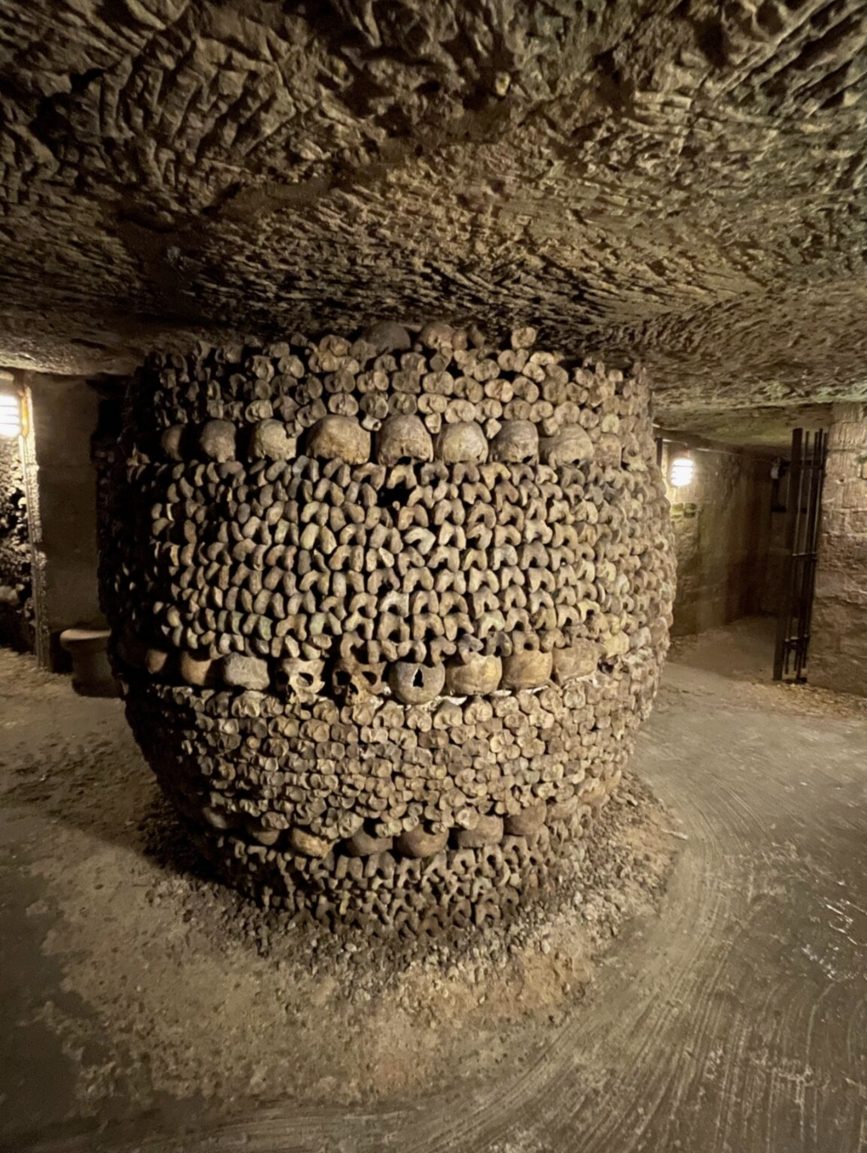
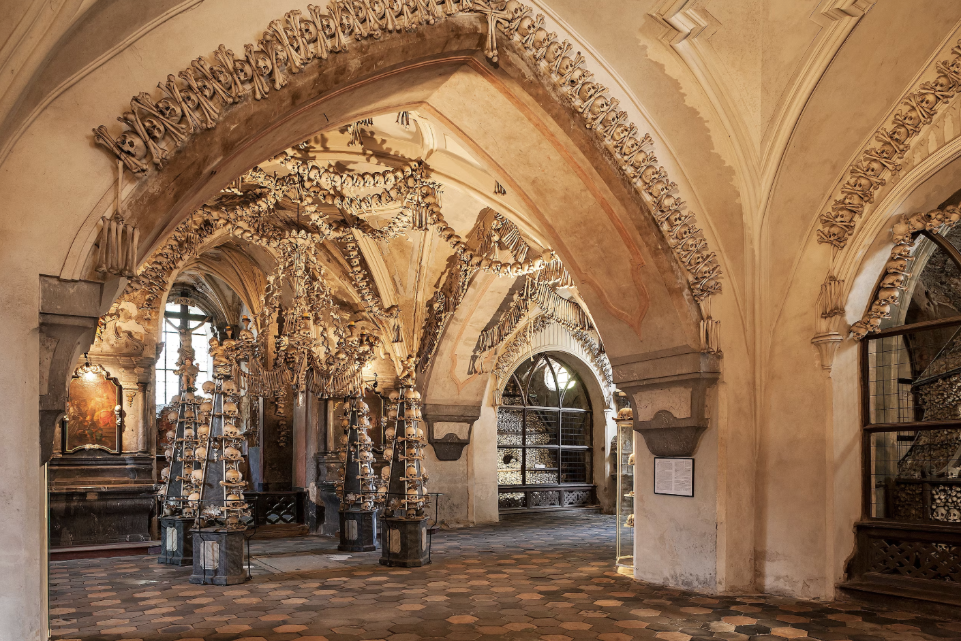
Bones as social mirrors

Slide 10
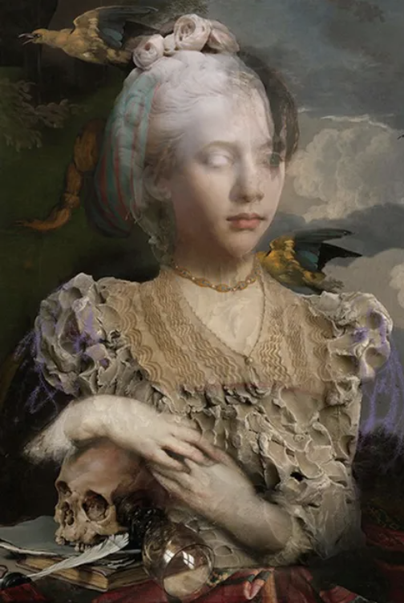
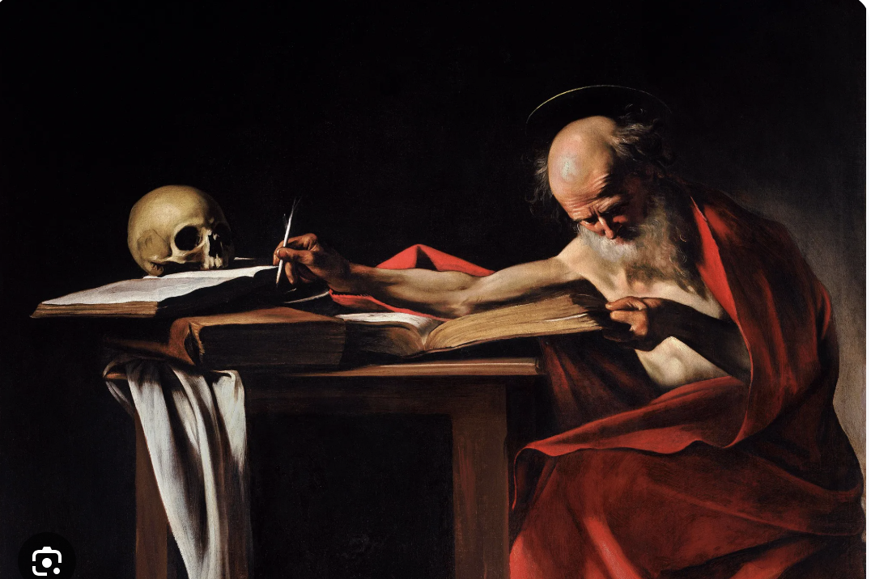
Bones as social mirrors
Memento Mori

Slide 11
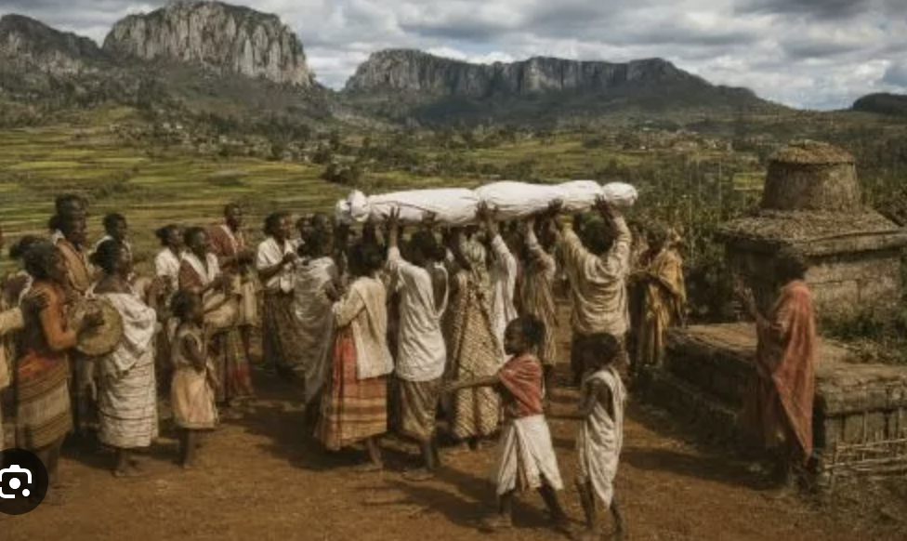
Bones as ancestral anchors
Famadihana - Madagascar

Slide 12
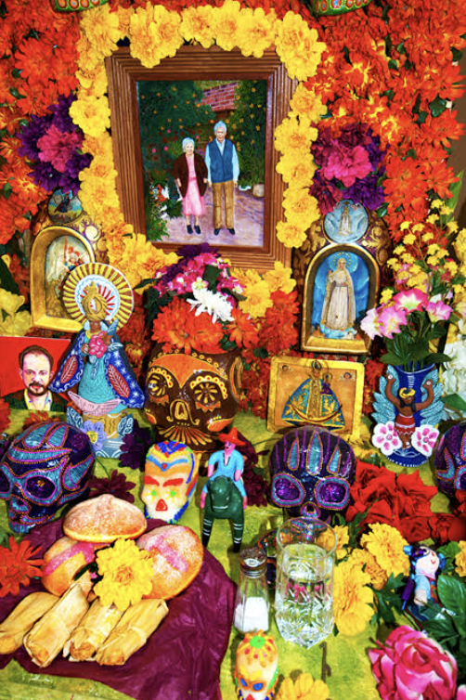
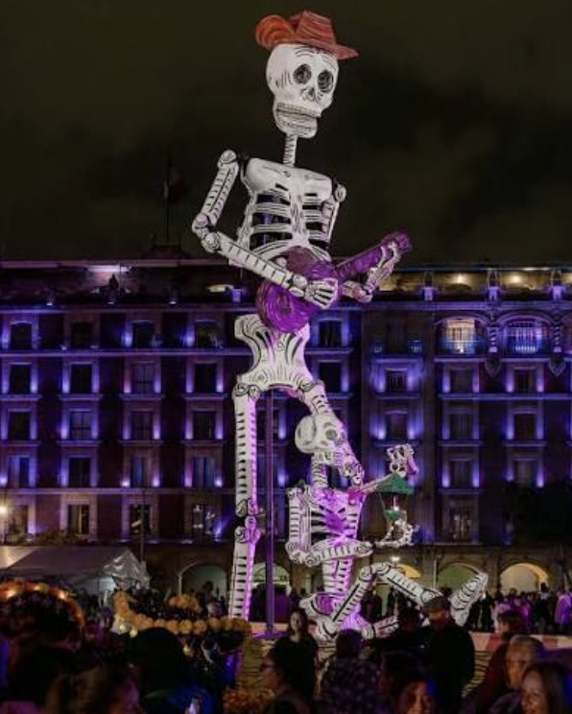
Bones as ancestral anchors
Dia de los Muertos

Slide 13
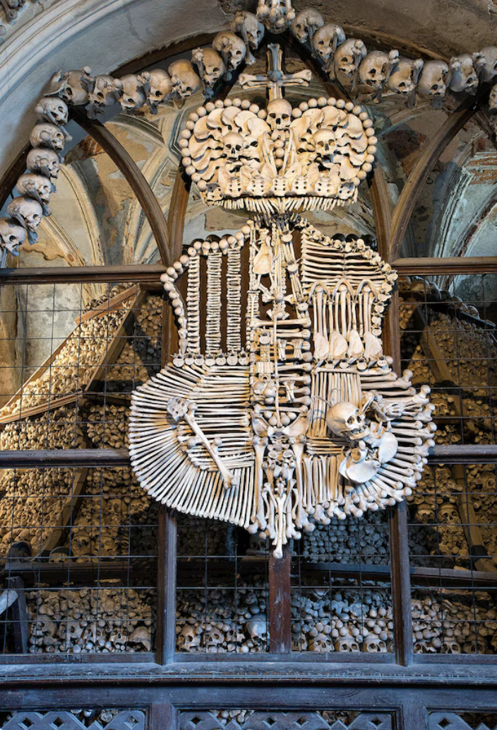
Conclusion
Bones are the architecture of our biology and our beliefs

